Slide 1
creating jupyter notebooks in virtual environments
Lab meeting 16/04/2020
Bernat Bramon Mora
ETH Zürich
Plant Ecology group

Slide 2
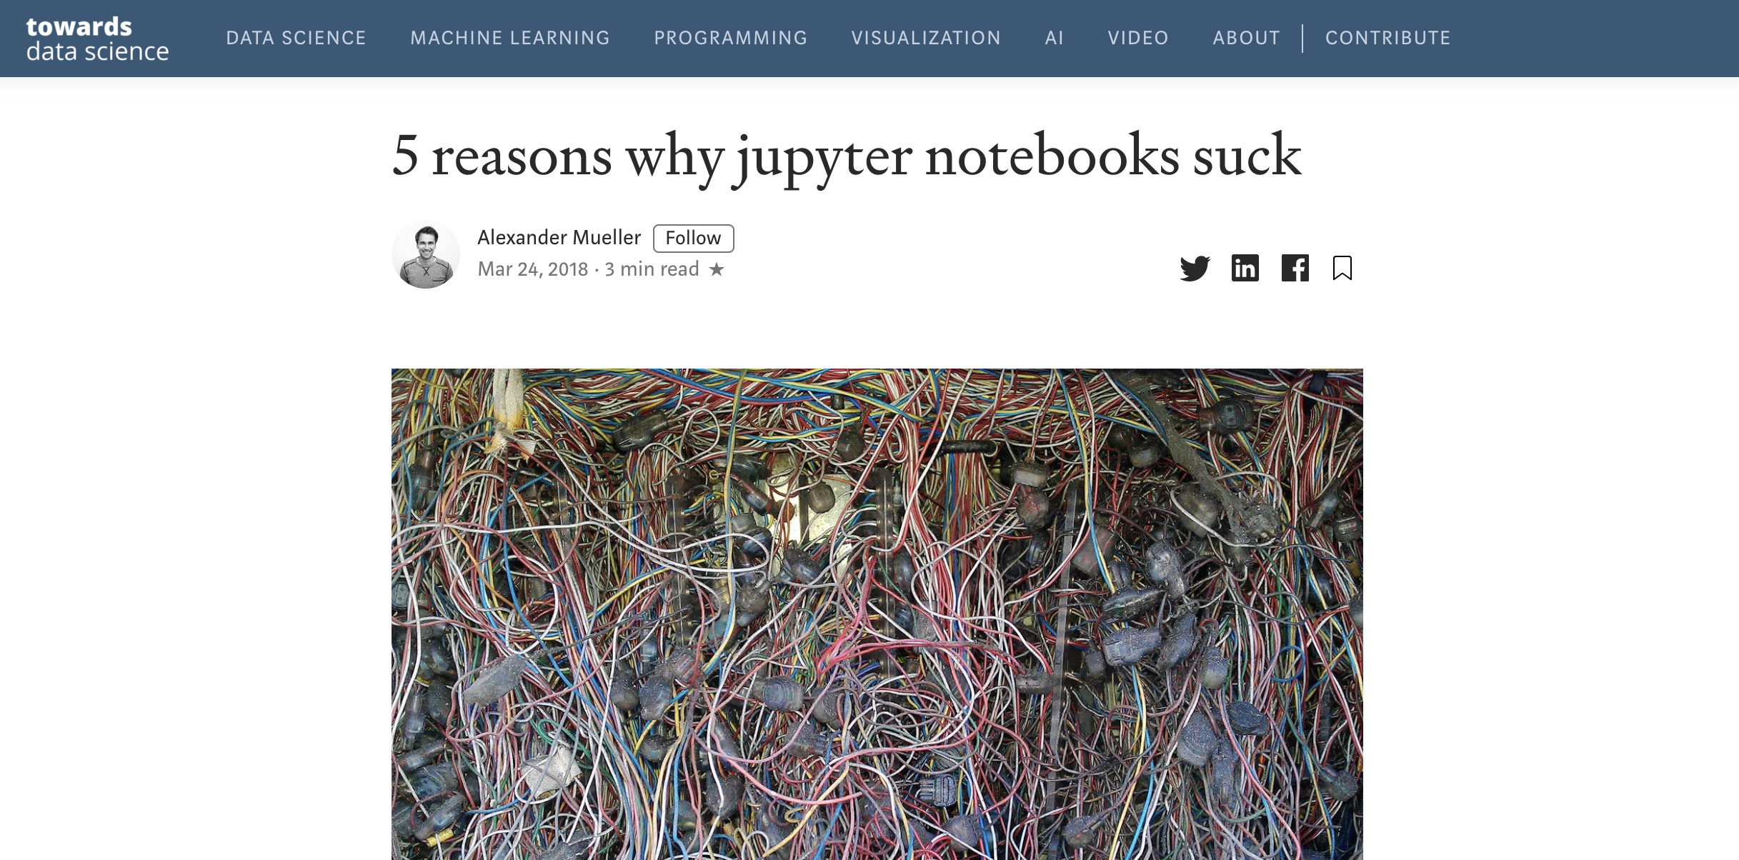

Slide 3
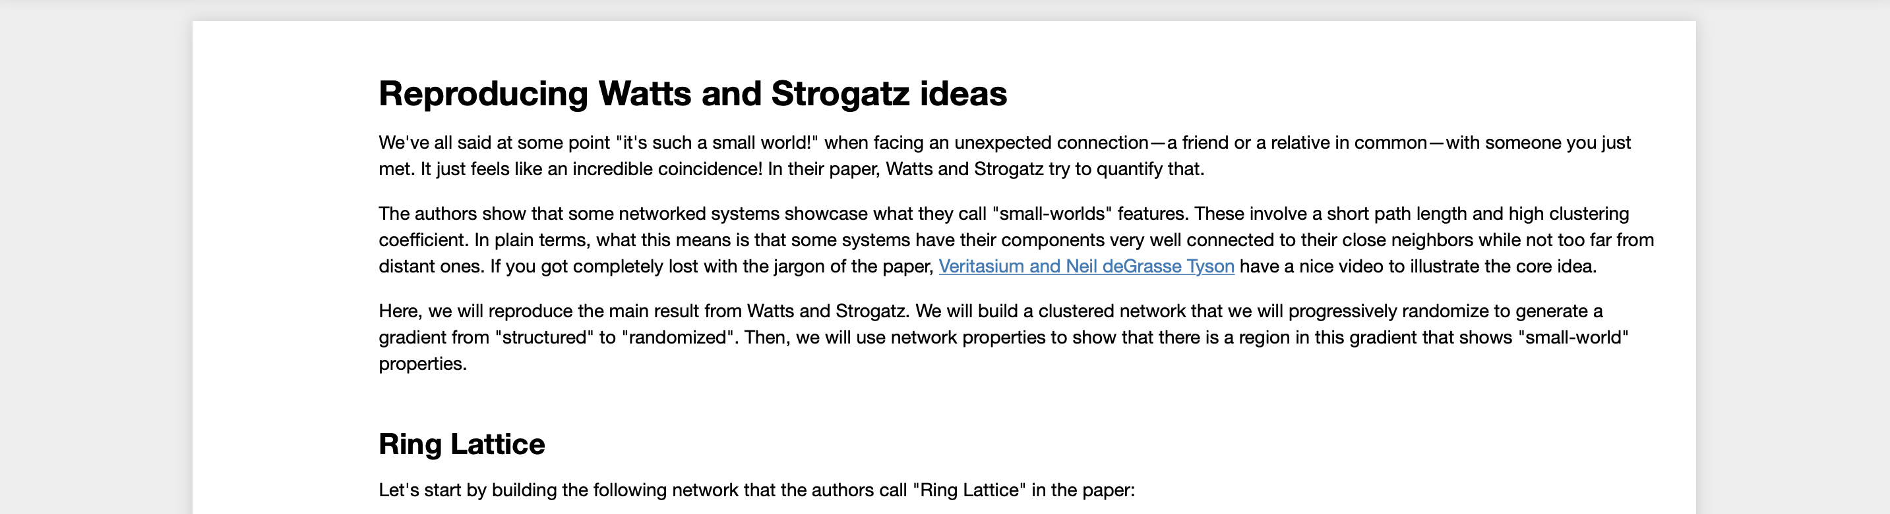
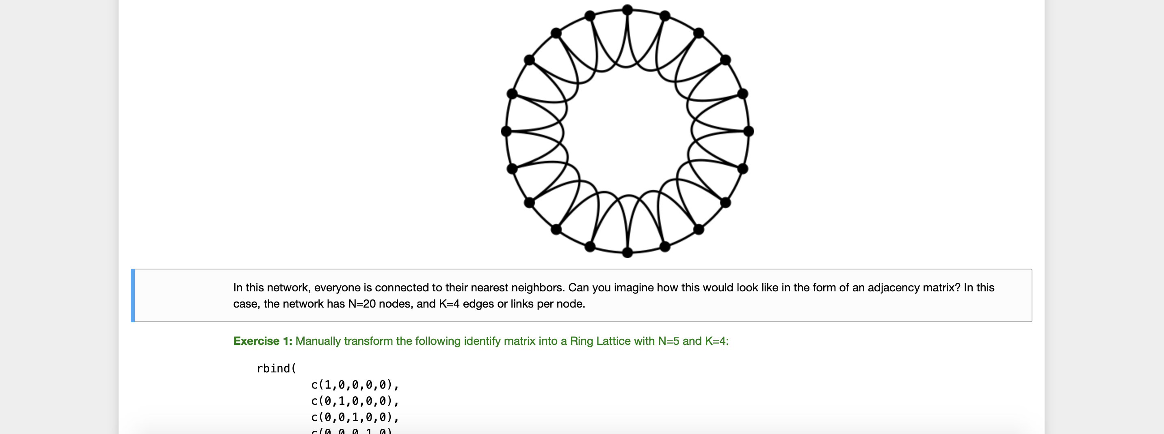

Slide 4
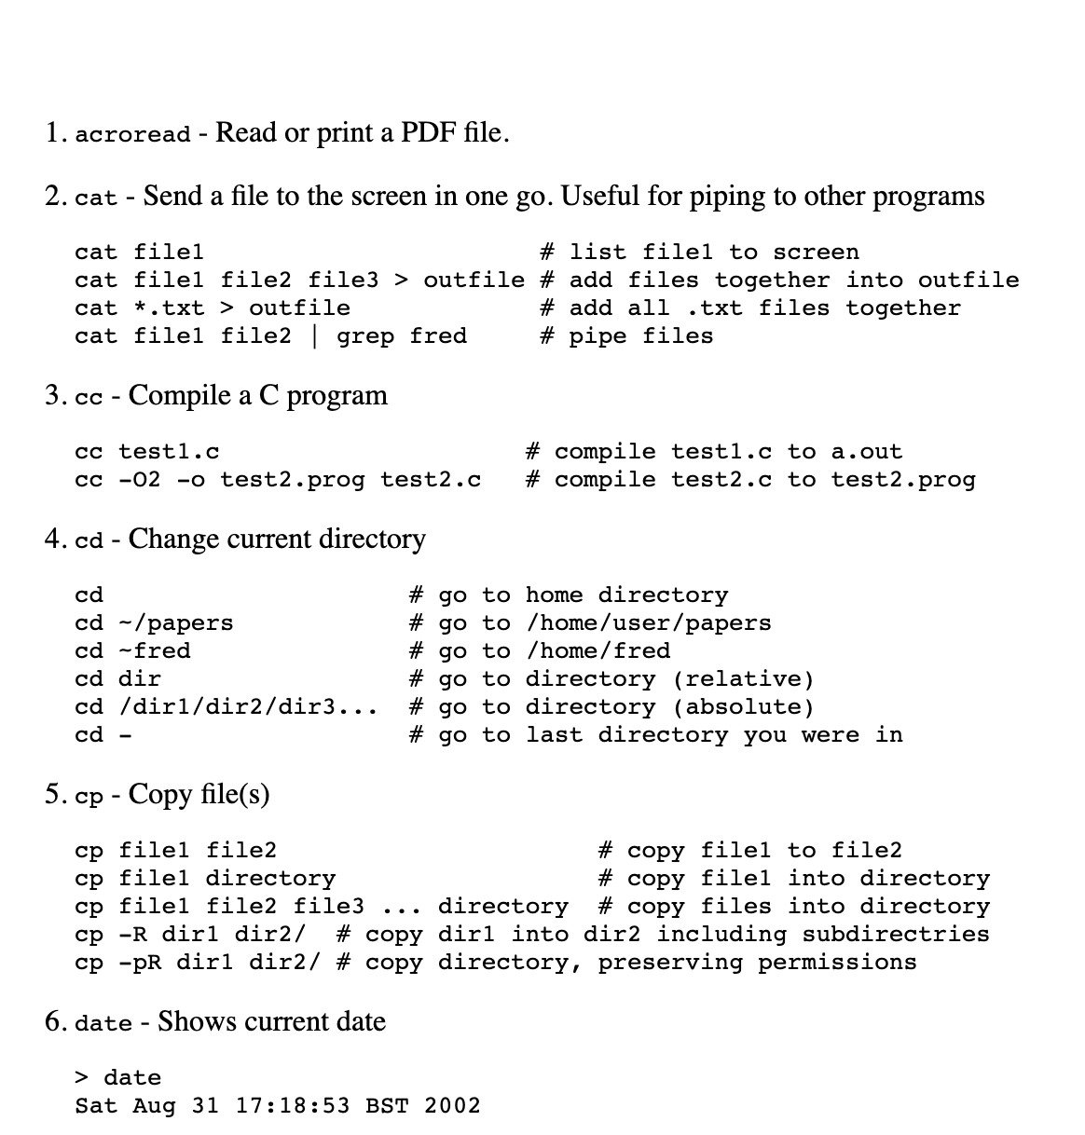
Basic Shell Commands
. . .

Slide 5

Basic Shell Commands
. . .

Slide 6
The basics: installing anaconda, jupyter and r-essentials

Slide 7

The basics: installing anaconda, jupyter and r-essentials

Slide 8
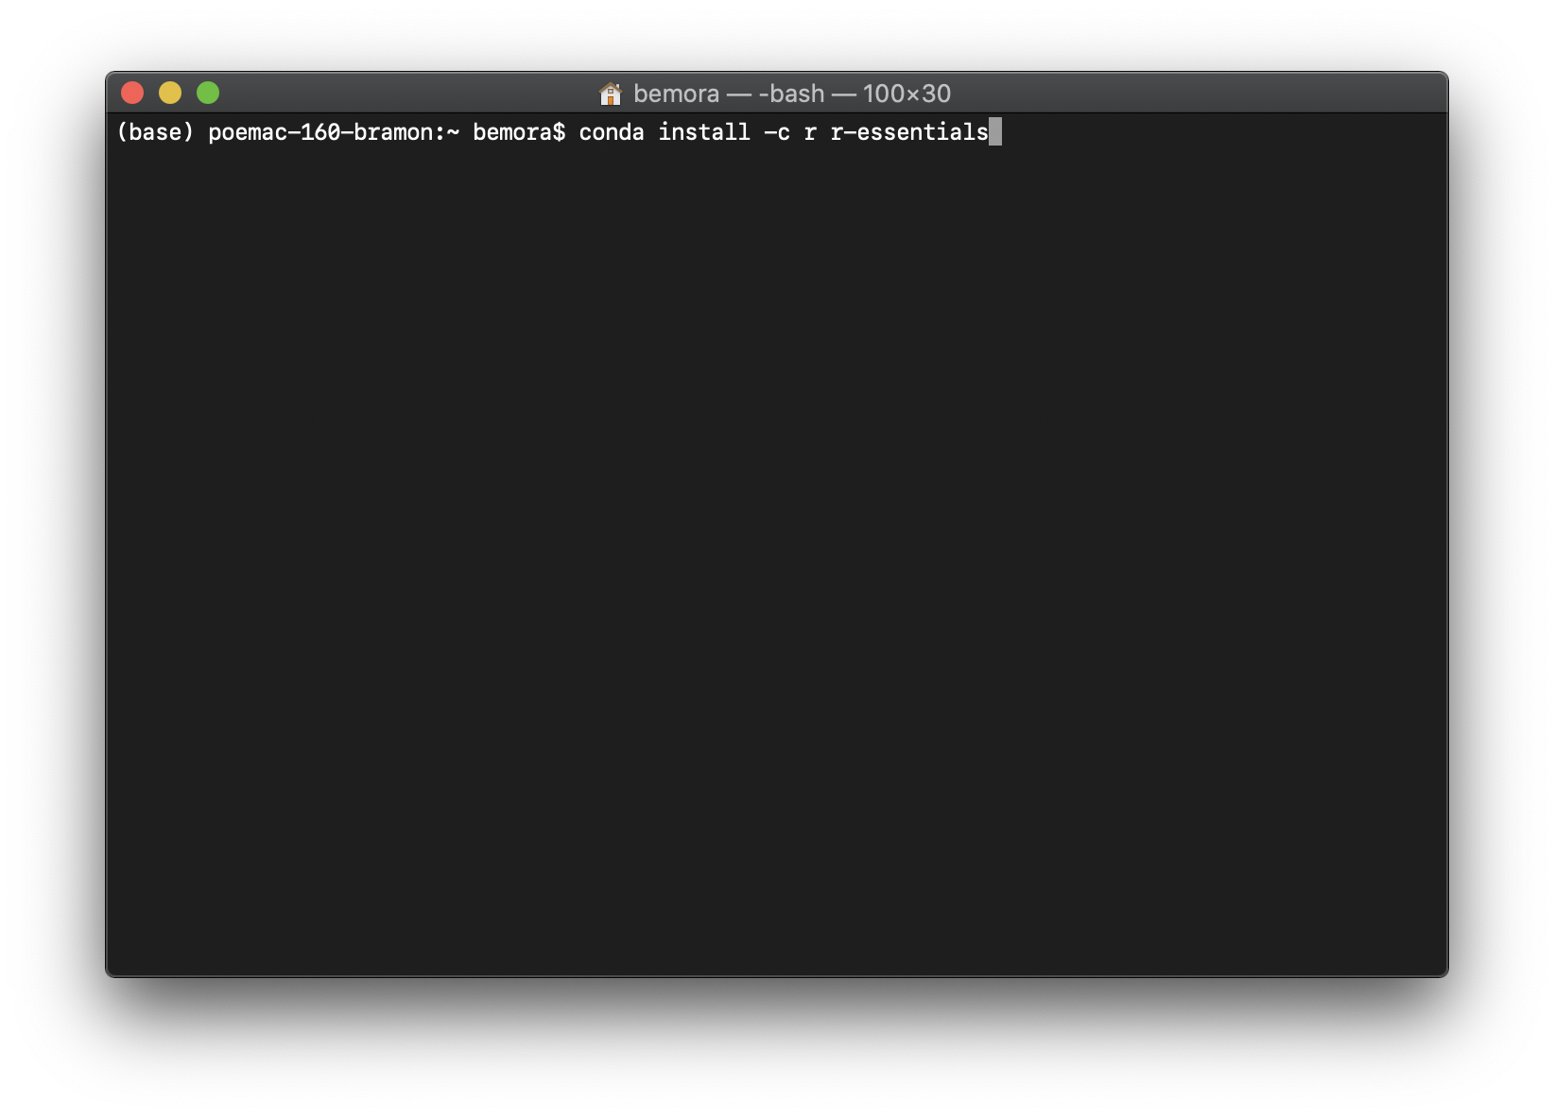
The basics: installing anaconda, jupyter and r-essentials

Slide 9
Type “jupyter notebook” in a terminal to start a notebook

Slide 10

Create a Github repository for your lecture

Slide 11
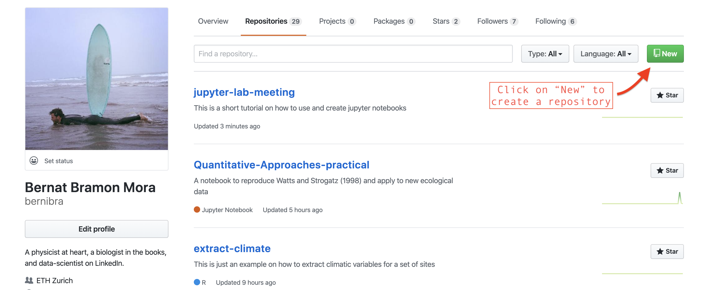
Create a Github repository for your lecture

Slide 12
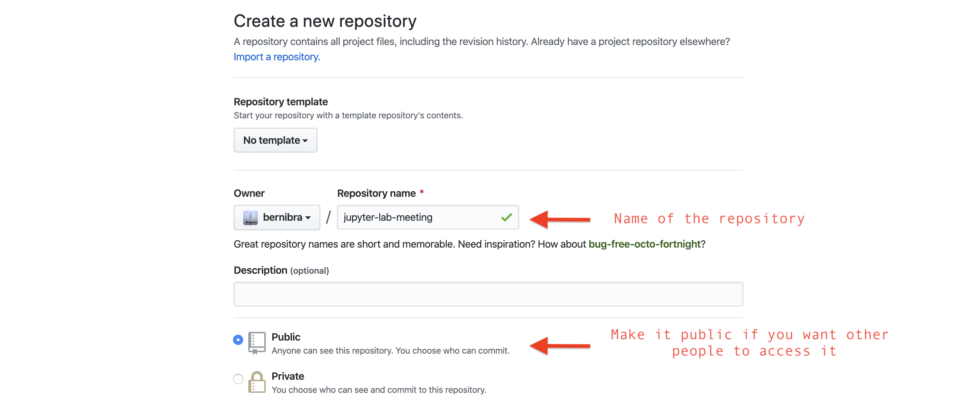
Create a Github repository for your lecture

Slide 13
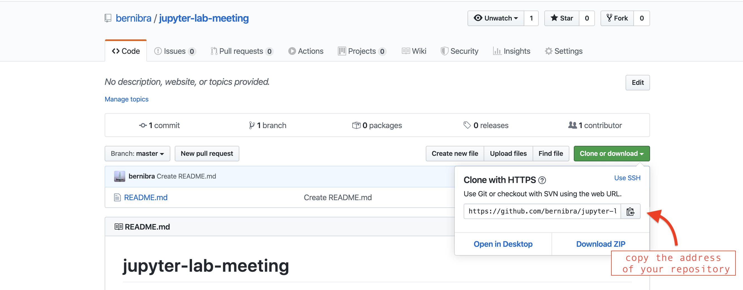
Create a Github repository for your lecture

Slide 14
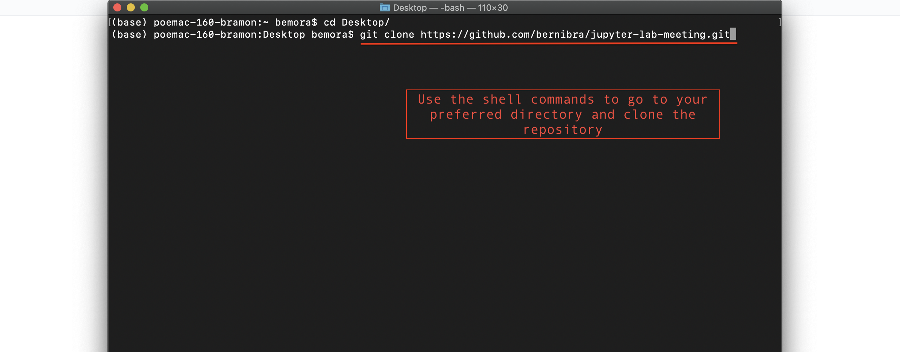
Create a Github repository for your lecture

Slide 15
Let’s just try to create one…

Slide 16
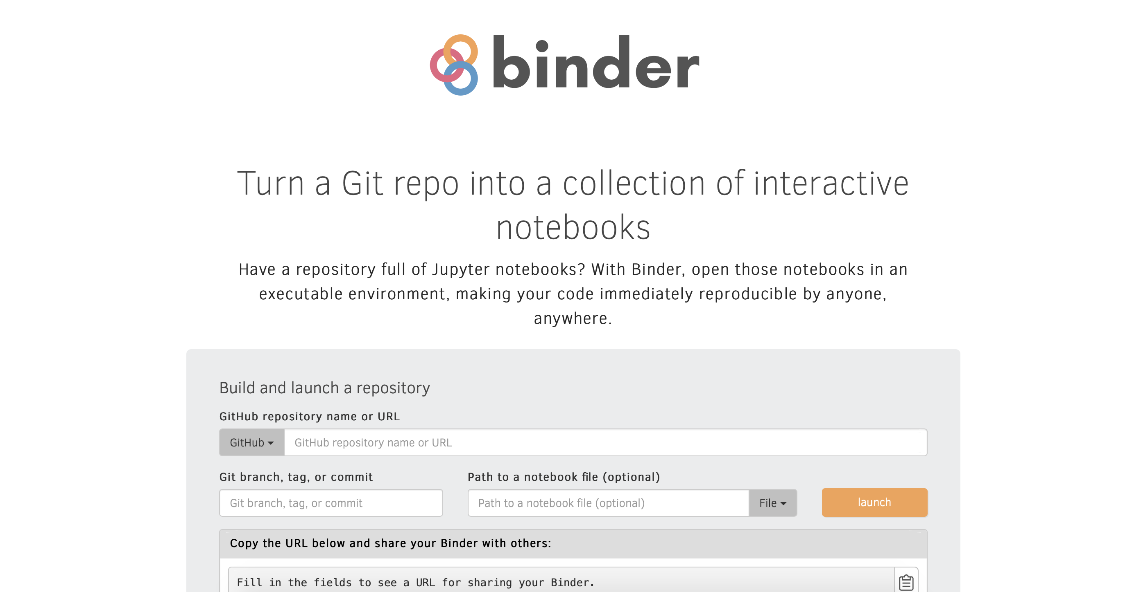
Using Binder to put your notebooks in virtual environments

Slide 17
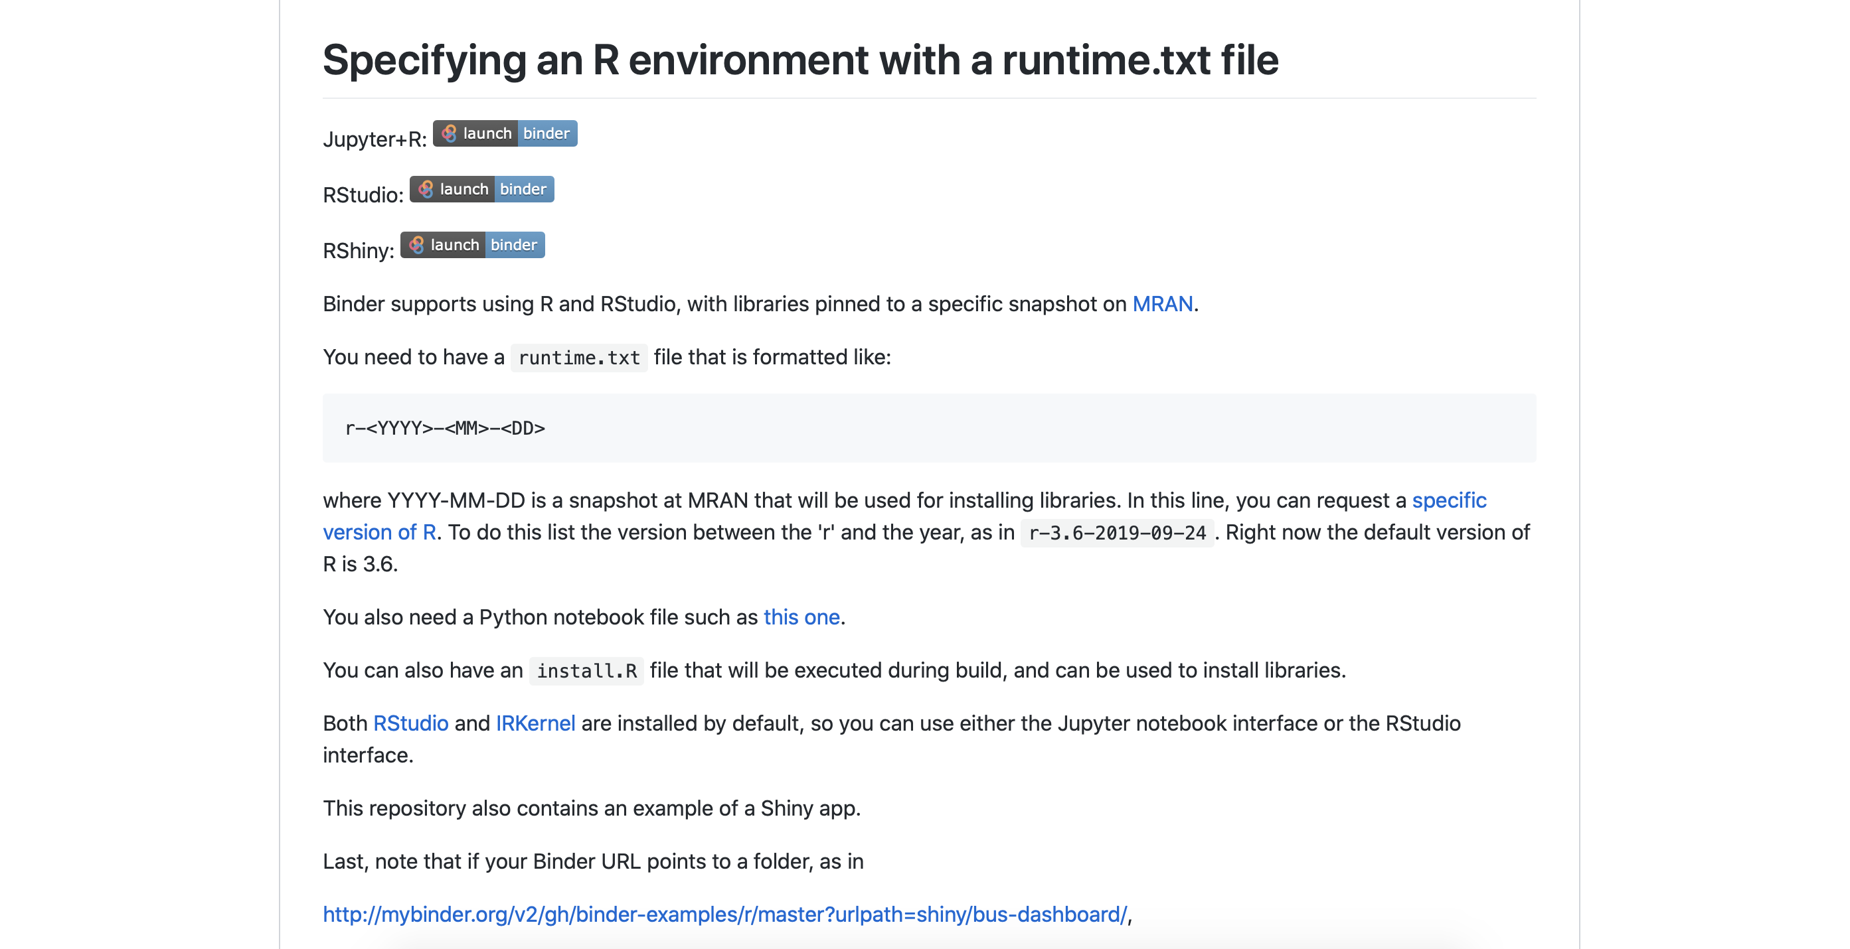
Using Binder to put your notebooks in virtual environments

